Slide 1
COOLANT STRUCTURAL MATERIALS
COMPATIBILITY
APEX Task III.6a
S. Sharafat and N. M. Ghoniem
The University of California at Los Angeles (UCLA)
Los Angeles, CA. 90095-1597, USA
Joint APEX Electronic Meeting
USA
March 24, 2000

Slide 2
KEY ISSUES FOR LIQUID METAL/STRUCTURE COMPATIBLITY
EFFECTS
Corrosion/Mass Transfer
  Uniform or selective dissolution
  Inter-granular penetration
  Interstitial-element transfer
Deposition of Corrosion Products

Wall Thinning
Degradation of
Strength

Pumping Power
Efficiency
Safety

Slide 3
(1) CORROSION/MASS TRANSFER
Variables:
  Liquid metal and type of impurities (N, O, C, etc.)
  Composition and microstructure of wall
  Temperature
  Exposure time
  System parameters :
    flow velocity, MHD, delta-T, surface area, bi-metallic or mono-metallic loop, system temperature profile.
Effects on Property Deterioration:
  Liquid metal embrittlement (LME)
  Oxidation, nitridation, carburization-decarburization
  Fatigue crack propagation
  Creep ductility loss

Slide 4
Task-III.6a APPROACH
Investigation Approach:
  Empirical Literature Data Extrapolation
  Thermodynamics of main compounds, for example:
    Li-Fe, Li-V, Li-W, Li-SiC
    Sn-V, Sn-Fe, Sn-W, Sn-SiC
    Flibe-Fe, Flibe-V, Flibe-W, Flibe-SiC
GOAL of Investigation:
Identify Temperature and Impurity Limits:

Slide 5
Data-Base Matrix
Available Data
Lacking Data
Liquid Metal
Li, Li17-Pb83, FliBe, Sn
Structural Materials
(Experimental)
Li & LiPb :
V-Ti-Cr
V-Cr-Ti-Zr
Fe-C-Cr-Ni-Mo, HT9
Li & LiPb :
W, W-Re,
ODS-W, SiC
Flibe,Sn-V,Fe,W, SiC
Insulating Ceramics
(Mostly thermodynamic analysis,
some experimental)
Li-Oxides: Y₂O₃, CaO, Al₂O₃,
MgO, SiO₂, Cr₂O₃
Li-Carbides: β-SiC, TiC, ZrC, TaC
Li-Nitrides: BN, AlN, TiN, ZrN,
VN, CrN
No info on SiC and FliBe or SiC and Sn-Li;
SiC unstable in Li, but stable in Li-Pb^{[1]}
Flibe, Sn & all
Impurities
(effects on compatibility)
Li containing O, N, C, H
Sn-Li, Flibe
[1] Hubberstey, 1997

Slide 6
AVAILABLE DATA BASES
Simple Phase Diagrams are available for:
  Lithium-Vanadium (Li-V):
  Li-Fe (compounds are thermodynamically unlikely to form: Positive enthalpy of formation)
  Tin-Vanadium (Sn-V)
  Tin-Iron (Sn-Fe)
  Thermo-physical data for Li and Sn are available
FliBe (LiF-BeF₂):
  Detailed phase diagram is available
  Thermo-physical data are available for:
    density, expansivity, viscosity, electro-conductivity, specific conductance, specific heat, enthalpy, entropy, free energy, heat of mixing, thermal conductivity, thermal diffusivity, Prandtl number, vapor pressure, compressibility, sound speed, kinematic viscosity, surface tension, some interfacial surface tension, solubility values (gases, Ni, Fe, Al), optical properties, self-diffusion coefficients.

Slide 7
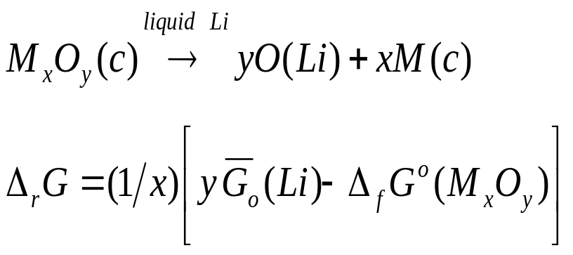

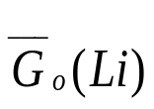
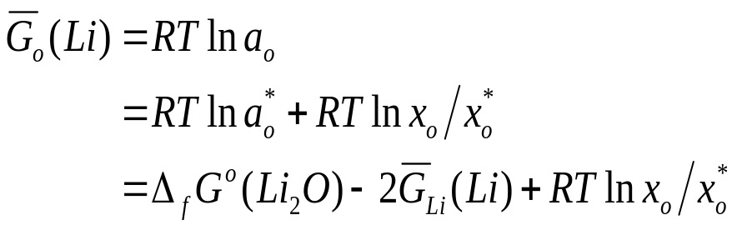



Thermodynamic Modeling for Chemical Stability of Coatings in Lithium
    As a function of (1) non-metal solute concentration (x_{x}), and (2) Temperature (T)
    Free energy changes of reactions (_{r}G):
      Standard free energy of formation data (need data for Sn to evaluate Sn-Li systems)
      Solute free energy is given by:
: oxygen activity at saturation
: oxygen concentration
: oxygen conct. at saturation

Slide 8
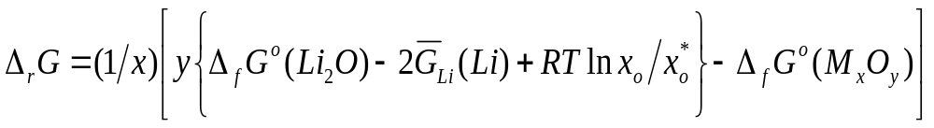
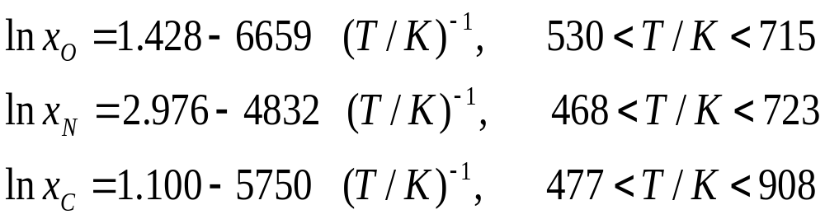
Thermodynamic Modeling for Chemical Stability of Coatings in Lithium
    Principal non-metal solutes in liquid lithium are: Li₂O, Li₃N, Li₂C₂, and LiH
    Solve for free energy change of reaction (_{r}G) (similar for N and C):
    Use established solubility expressions for oxygen, nitrogen, and carbon in Li:

Slide 9
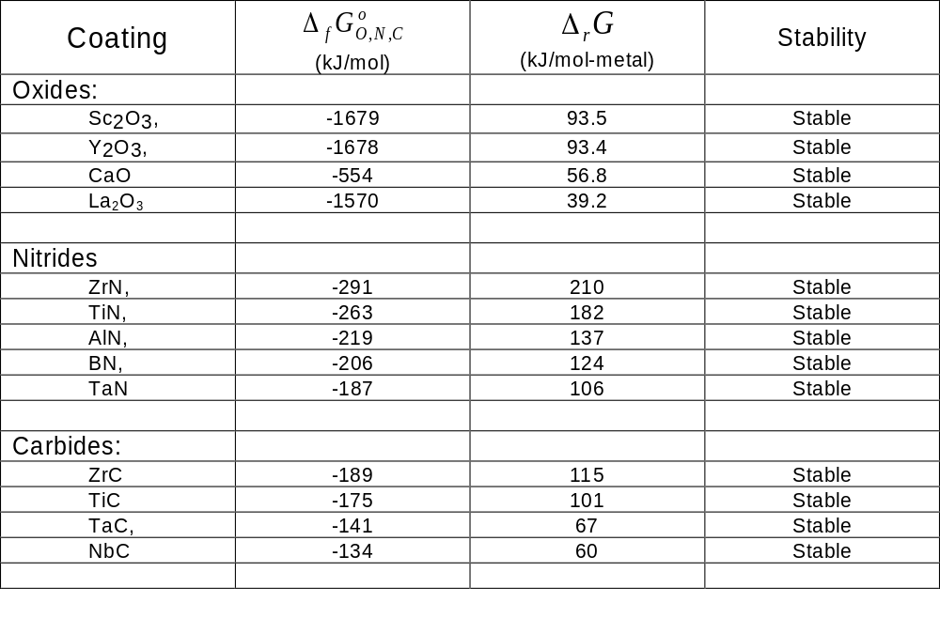
Thermodynamic Modeling for Chemical Stability of Coatings in Lithium
    Based on the above model the chemical stability of coatings can be determined:

Slide 10
Thermodynamic Modeling for Relative Stability of Coatings in Lithium
The stability of coatings is critical for minimizing MHD pressure drop effects.
Oxides, Nitrides, and some Carbides have been investigated as potential coating candidates for vanadium alloys.
Most stable ceramic coatings (in order of stability):
  Oxides:
    Sc₂O₃, Y₂O₃, and CaO
  Nitrides:
    ZrN, TiN, AlN, BN, TaN
  Carbides:
    ZrC, TiC, TaC, NbC

Slide 11
Conclusions
The most stable coatings for a Lithium are:
  Oxides: Y₂O₃, Sc₂O₃
  Nitrides: ZrN
  Carbides: ZrC
Plan to apply thermodynamic model to determine the stability of coatings in a Sn-Li and in Flibe.

